Slide 1



1st UEMS Congress
Learning • Networking • Impacting
27-30 May 2026
UZ Leuven, Campus Gasthuisberg, Leuven (BE)
www.uemscongress.eu

Slide 2
1st UEMS Congress
Learning & impacting sessions, among which:
Networking & connecting opportunities
Participation of key European health stakeholders & experts
European health
AI/ Machine learning: training perspectives
European medical workforce
European health/ healthcare systems in crisis (new pandemics, naturals disasters, terror attacks, war)
Mental health in the medical profession
Green & sustainable practice
Work-life balance
Response to disasters
Oral Presentations
Workshops
Symposium
Debates
Panel Discussions
Networking Reception
Congress Dinner

Slide 3

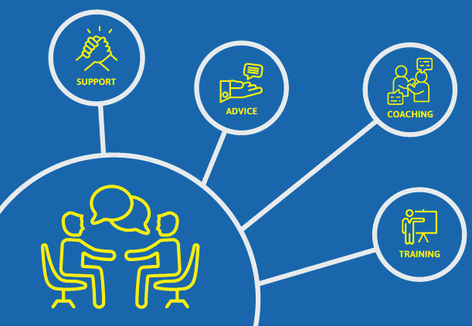
Mentorship initiative
A unique opportunity to:
Connect with colleagues from across Europe.
Engage in one-to-one conversations on professional and medical matters.
Exchange insights on healthcare systems, specialist training, and career development.
Offer or receive advice, support, and guidance in a collegial and informal setting.
More information & to submit applications to become mentor or mentee or both on UEMS website

